Slide 1
KHOELETSO EA LIHOOAI
REA IPOPA LIHOAI
C&P Course
Notes:
Note:

Slide 2
KHOELETSO EA LIHOOAI
UNIT 1. INTRODUCTION
1.1. ABOUT
1.2. PROBLEM STATEMENT
1.3. HYPOTHESIS
UNIT 2. OVERVIEW
2.1. Use case diagram
2.2. Table mapping
2.3. System interface
UNIT 3. CONCLUSION
3.1. PROBLEMS ENCOUNTERED
3.2.LONG TERM-GOALS
3.3. SUMMARY
Notes:
Note:

Slide 3
UNIT 1- ABOUT 1.1. INTRODUCTION
Khoeletso ea lihooai is an online platform that showcases products of different entrepreneurs in the agricultural sector aimed at solving promotional issues involving advertising and accessibility of their produce.
Khoeletsadvertising and accessibility of their produce
Notes:
Note:
Some examples of random experiments are:
+Flipping a coin.
+Rolling dices.
You will start with these simple examples and build a basis of probability.

Slide 4
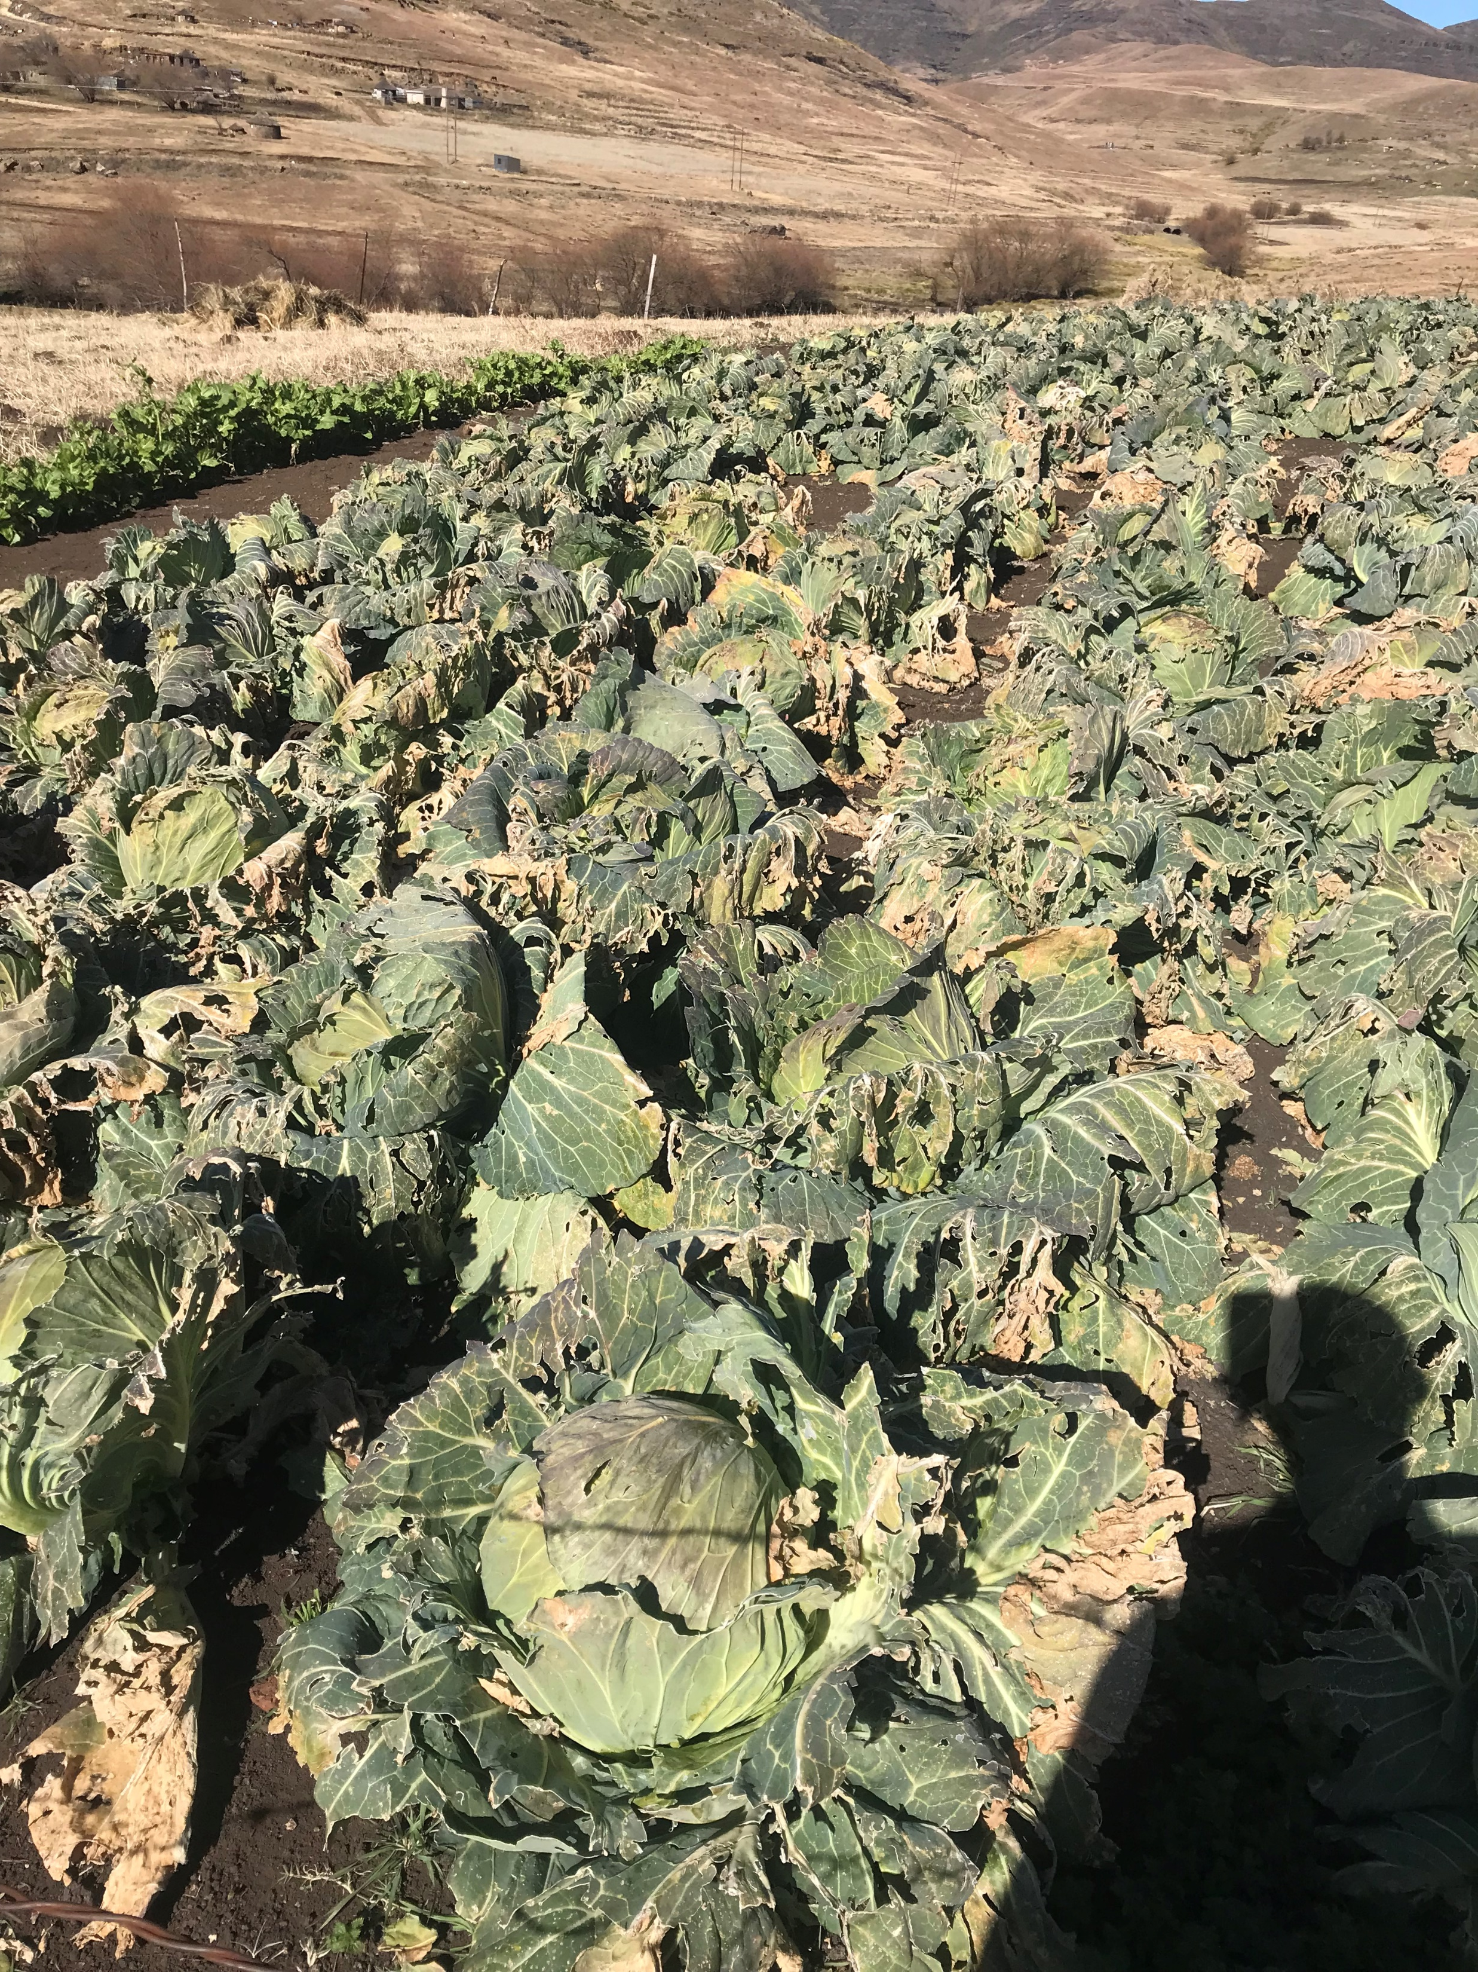
UNIT 1 - ABOUT
1.2 PROBLEM STATEMENT
1.2PROBLEM STATEMENT
In Lesotho, a pressing challenge arises from the inadequate agricultural infrastructure and limited access to markets hampering farmers to market their produce efficiently.
Concurrently, a barrier in promoting their produce due to lack of lack of online platforms and secure payments methods as such these limitations curtails economic opportunities for self-employed individuals such as farmers.
Needless to mention the unreliable supply chains and delays in payments exacerbate struggles. Consequently, there is an urgent need for a comprehensive locally tailored digital platform that connects farmers with markets as well as the fitted ministry in Lesotho.

Slide 5
UNIT 1-ABOUT
1.3 HYPOTHESIS
1.3 HYPOTHESIS
Khoeletso ea Lihoai will empower farmers in Lesotho by enhancing their access to markets and optimize supply chains enabling them to promote their produce efficiently.
Simultaneously uplifting self-employed farmers without specific skill-set by providing a space to showcase their products all while connecting them with potential buyers as well as employers within our country.
Critically addressing the economic disparities and unemployment in Lesotho hence Khoeletso ea Lihoai serves as a multifaced solution.

Slide 6
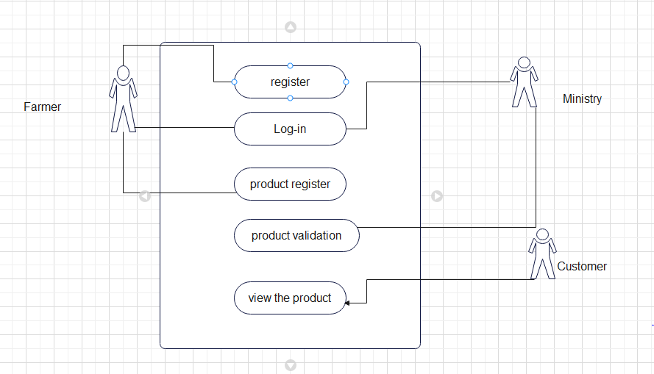
UNIT 2- OVERVIEW
2.1 Khoeletse System model(use case diagram)
Farmer should be able to register with the system.
After registration, Farmer should login and register product.
The Ministry should be able to approve or disapprove registered products.
The customer should b e able to view available products for sale.

Slide 7
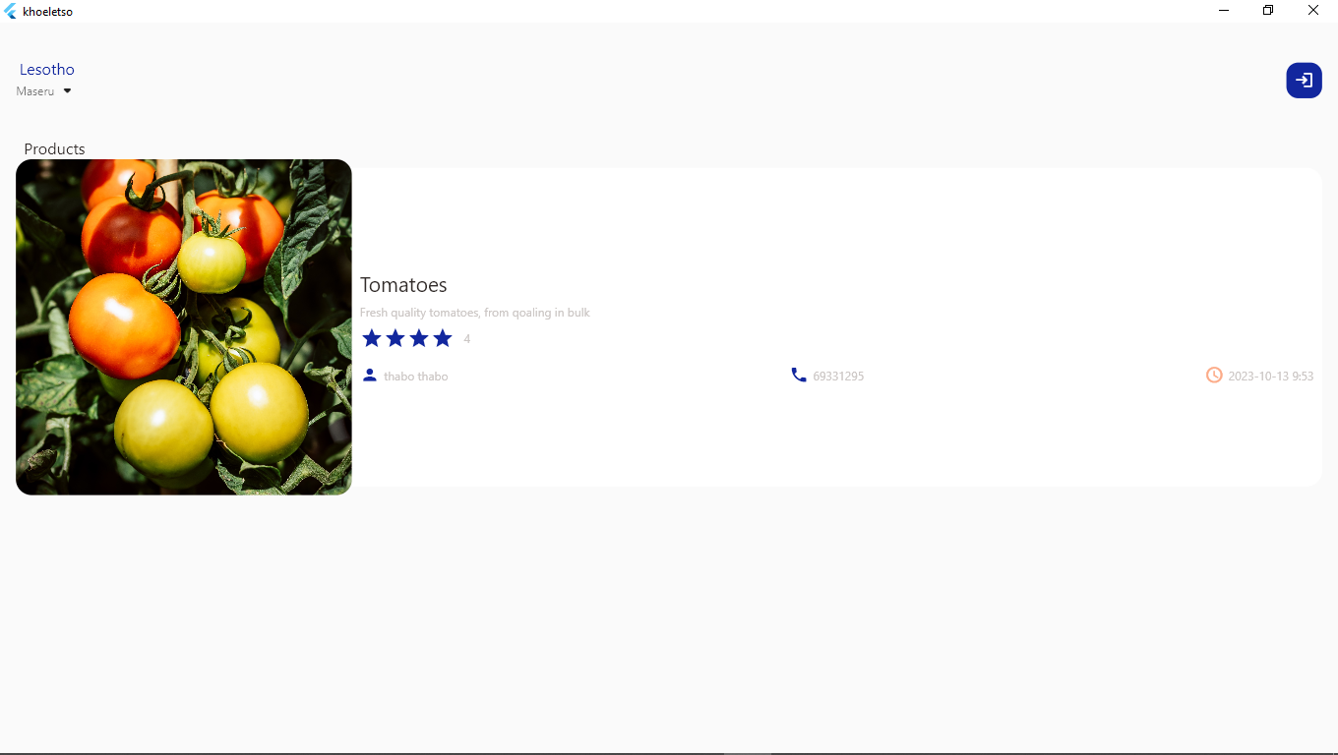
UNIT 2 - OVERVIEW
2.3 System interface Customer page
This is the first page of the app where the user is able to view all available products ready for sale.

Slide 8
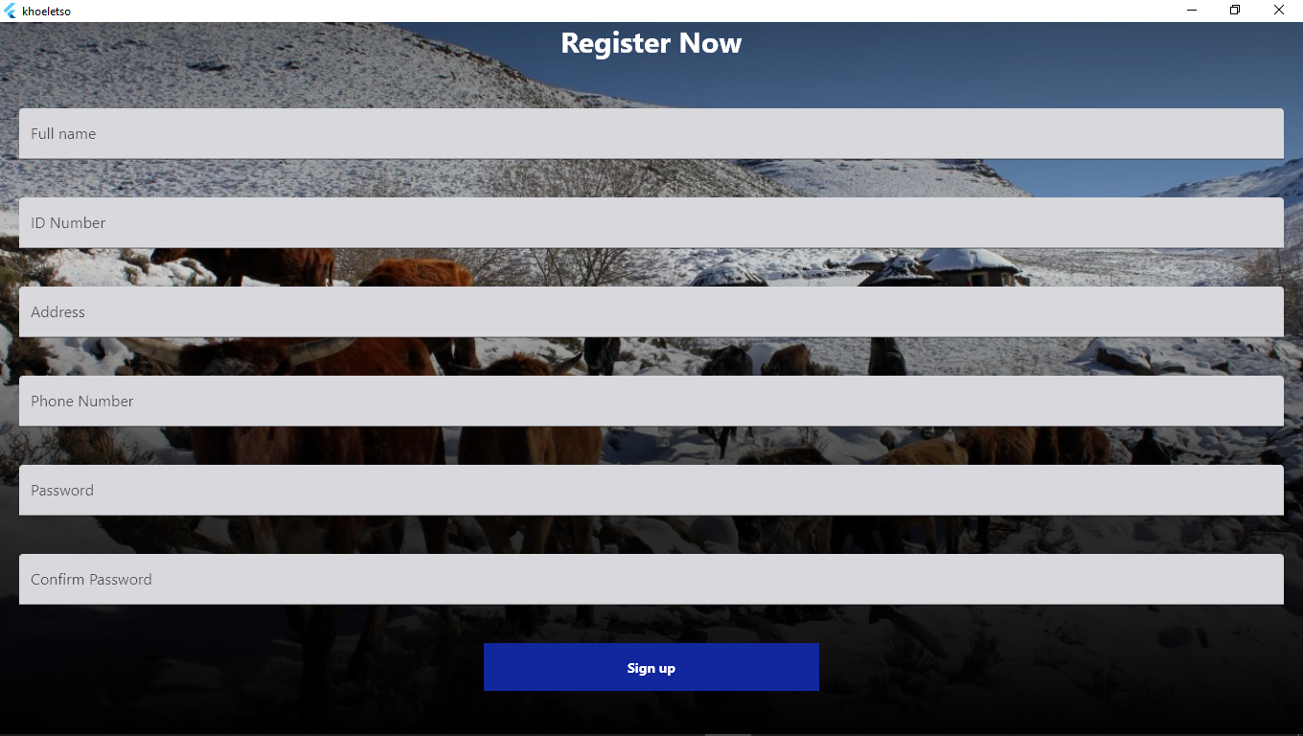
UNIT 2-OVERVIEW
User registration
This is the farmer registration form.

Slide 9
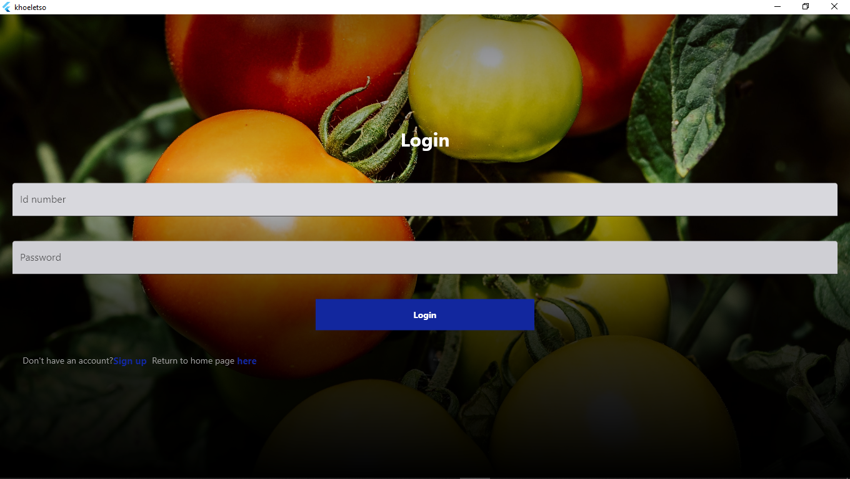
UNIT 2-OVERVIEW
Log in page
This is the log in page after registration.
User login details fields(id number)
Login button

Slide 10
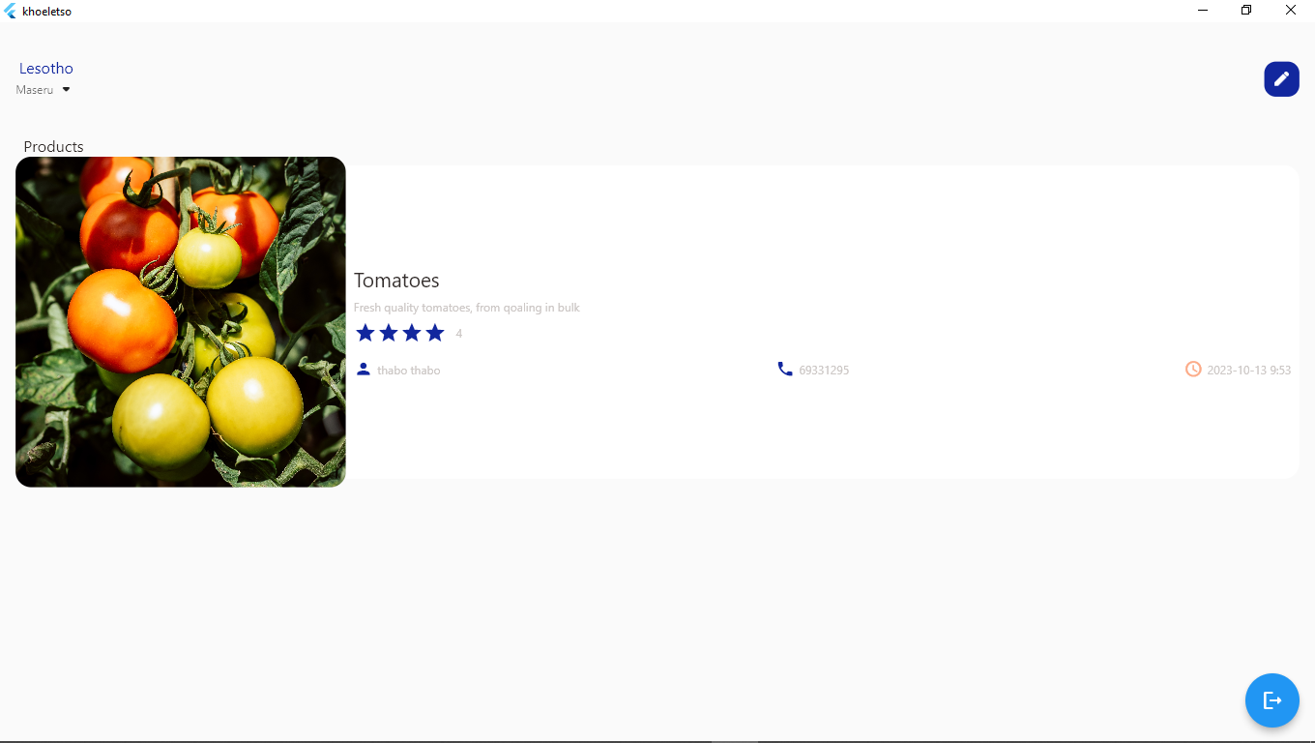

Slide 11
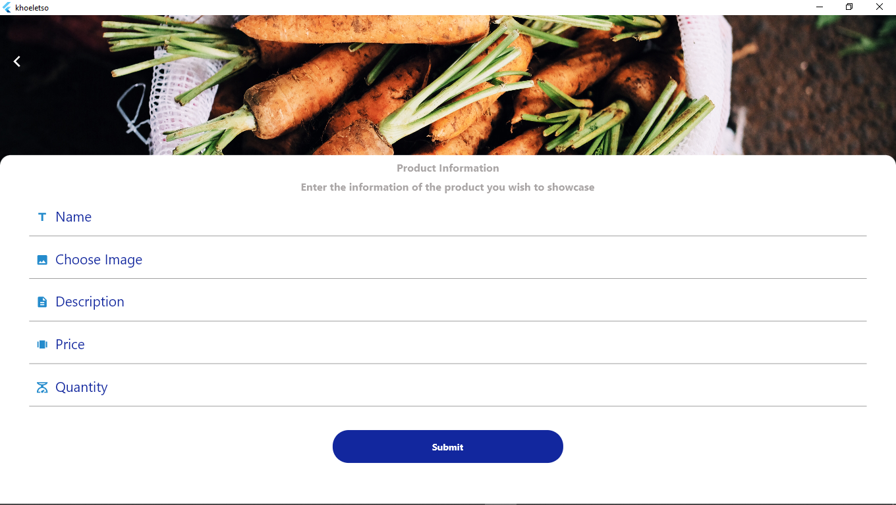
UNIT 2- OVERVIEW
Products registration page
This is the page where the farmer is able to register their products.
Fields to capture product data
+
Submit button after confirmation provided data

Slide 12
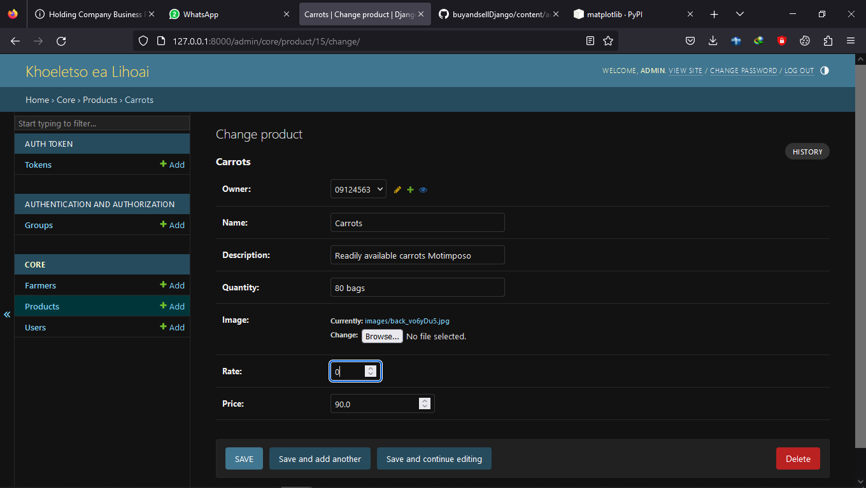
UNIT 2- OVERVIEW
APPROVAL PAGE
This is the page where the ministry rates and approve products so that they can be viewed by customers.
Save to confirm product button
Delete record if confirmed by mistake

Slide 13
UNIT 3-CONCLUSION
3.1 PROBLEMS ECOUNTERED
3.1 PROBLEMS ECOUNTERED
Linking back-end and front end posed a major challenge during the application development phase using python in regard to compatibility and communication of both end technologies.
Moreover uploading pictures was not particularly a walk in the park due to file size and format as well as the security of images.
As if we did not encounter ample setbacks, power-cut was a virtue followed by a discord in testing the log-in ascribed to bad conversion in Jason .
Over and above that, Django server did not run as expected .Agitation with shutting down machines on the account of technical problems.

Slide 14
UNIT 3-CONCLUSION
3.2 LONG-TERM GOALS
3.2 LONG-TERM GOALS
User growth
Trading should be done through the system
Product Review by Customer
Filter Products according to regions

Slide 15
UNIT 3-CONCLUSION
3.3 SUMMARY
3.3 Summary
Khoeletso ea lihooai is essentially a transparent digital platform to both proposed parties.
Moreover, digital marketing is the way forward and if done right an unprecedented sales boom is just within reach.

